Slide 1

DATA ANALYSIS ON NETFLIX TITLES
Motivation
Investigating content that is most prefereed by Netflix consumers so that Netflix is capable of knowing where to invest when producing.
NAME: … SCHOOL: … DEPARTMENT: …

Slide 2
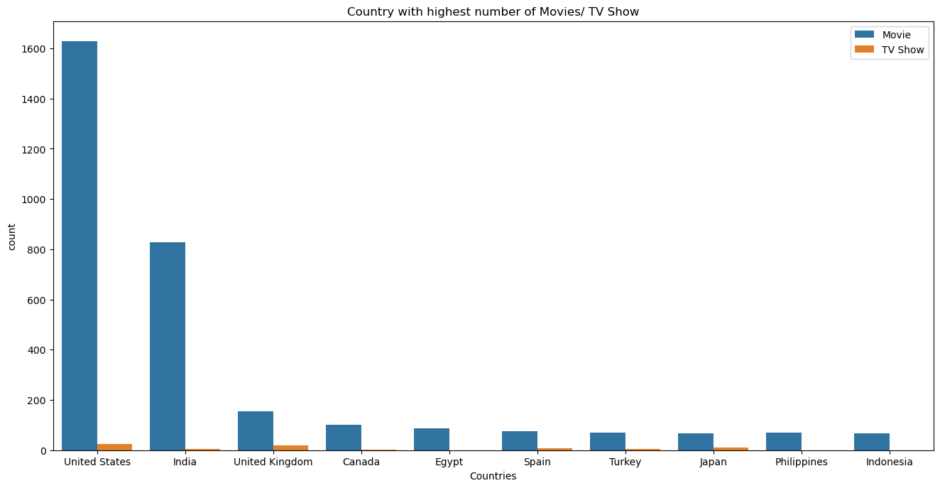
Data Visualization
United States has the largest viewership followed by India and United Kingdom.

Slide 3
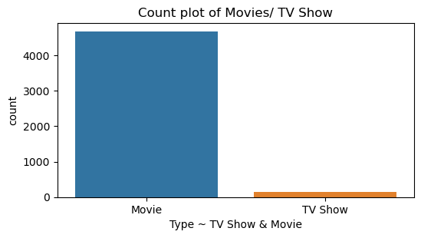
Data Visualization
Movies have gotten more popular than TV shows.

Slide 4
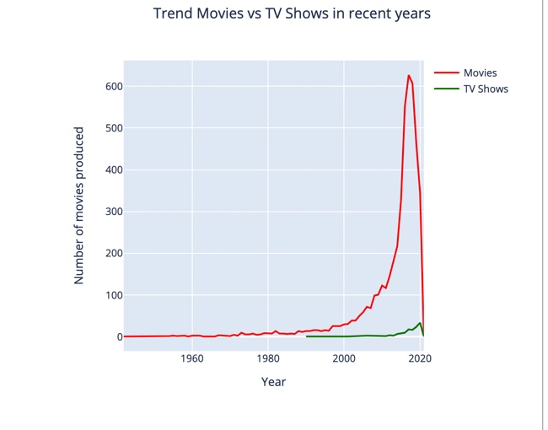
Data Visualization
Netflix is investing in more movies each year than in TV shows.

Slide 5
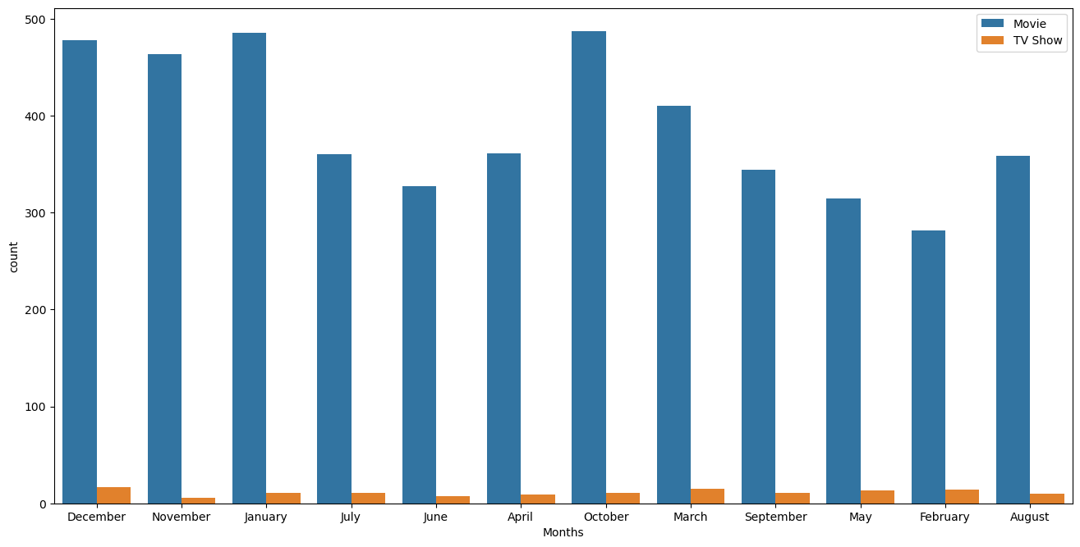
Data visualization
Movies are produced mostly. In the month of October , January and December.

Slide 6
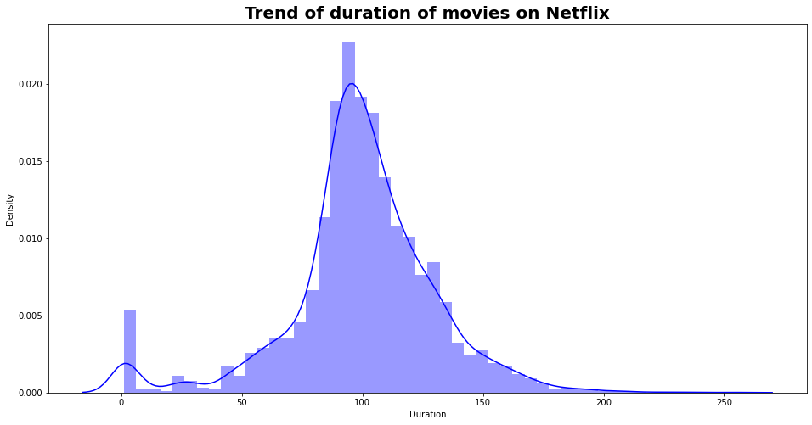
Data Visualization
Majority of the movies produced have a range of between 85 minutes to 120 minutes.

Slide 7
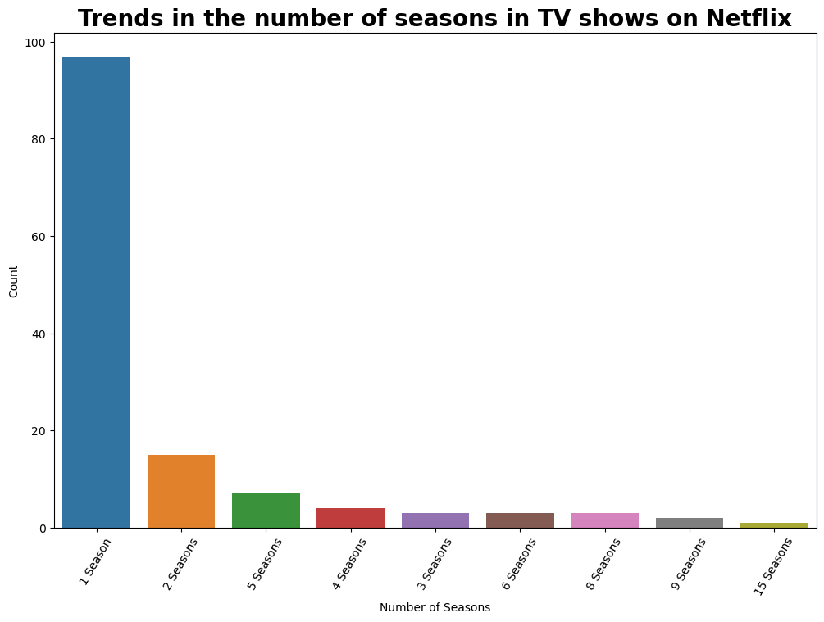
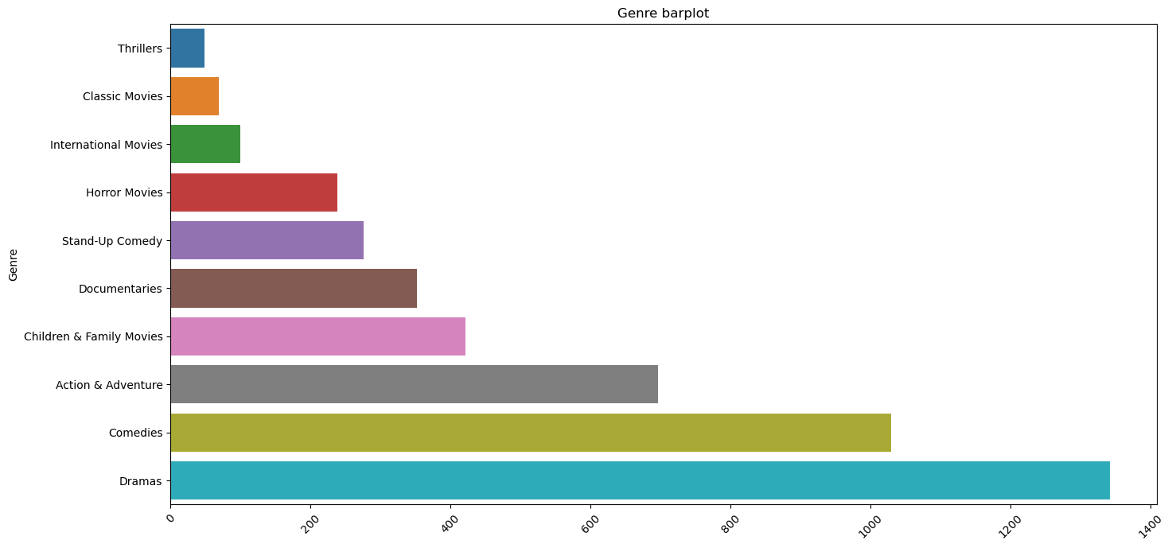
DataVisualization
Majority of the seasons consists of 1, 2 and 5 seasons.
Under movies section people prefer watching Dramas and Comedies

Slide 8
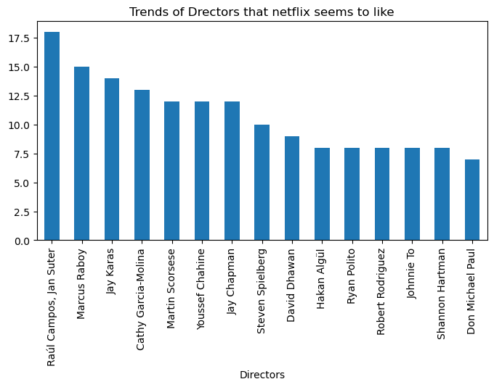
Data Visualization
Raul Campus, Jan Suter and Marcus Raboy are preferred by Netflix consumers.

Slide 9
NAIFLIX RECOMMENDATIONS
Naiflix should as well adopt the business model of producing TV-Show with not more than 5 seasons.
Naiflix should release movies in October, January and December respectively since viewership is highest in those months.
Naiflix should focus on producing movies that ranges from 85 – 120 minutes this is because movie consumers prefer watching movies of the specified range.
Naiflix to produce more movies in United States, since movies are most preferred by its consumers in that areas.
Naiflix, under movie genre, should focus on producing comedies and dramas.

Slide 10
ANY QUESTIONS
Thank you.

